Slide 1
Stent - Save a life! Initiative The Indian Experience
Dr Thomas Alexander
Director STEMI India
Co-Chairman, Stent - Save a Life!, and
Head of Cardiology, Kovai Medical Center and Hospital, Coimbatore, India
Azerbaijan Society of Cardiology Annual Meeting December 10th, 2022
Endorsed by

Slide 2
Epidemiological Transition Level
Empowered Action Group States
Dr Thomas Alexander

Slide 3
Findings from the Global Burden of Disease Study 2017
Source: GBD 2017 Population and Fertility Collaborators. Population and fertility by age and sex for 195 countries, 1950–2017: a systematic analysis for the Global Burden of Disease Study 2017. The Lancet. 8 Nov 2018: 392.
Dr Thomas Alexander

Slide 4
Agenda
The TN STEMI Program and the STEMI India Model
Challenges in STEMI Management
Benefits of a STEMI System of Care
Infrastructure appropriate variations of the Hub and Spoke Model
Implementation of the STEMI India Model
Global Programs
Dr Thomas Alexander

Slide 5
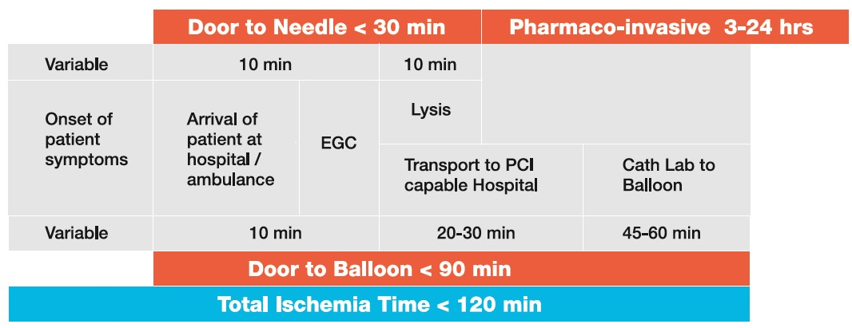
STEMI India Model
The STEMI India Model
Dr Thomas Alexander

Slide 6
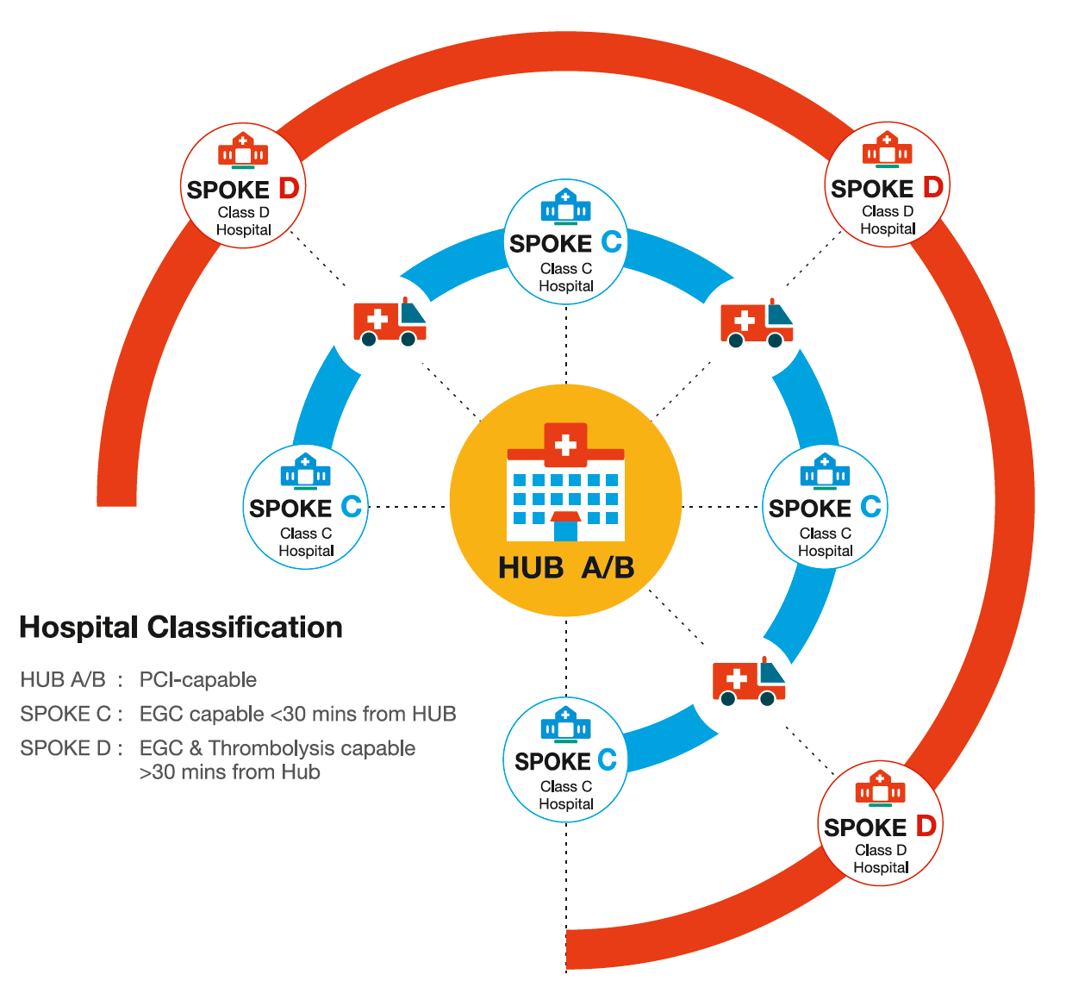
The STEMI India Model
The STEMI India Model
Cluster created
Hub-and-spoke model
Linkages built on
Electronic Data Communication
Management Protocols
Insurance reimbursement
Dedicated EMS Network

Slide 7
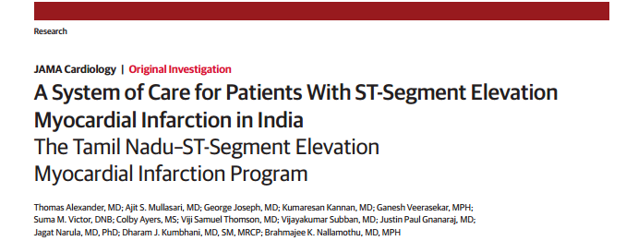
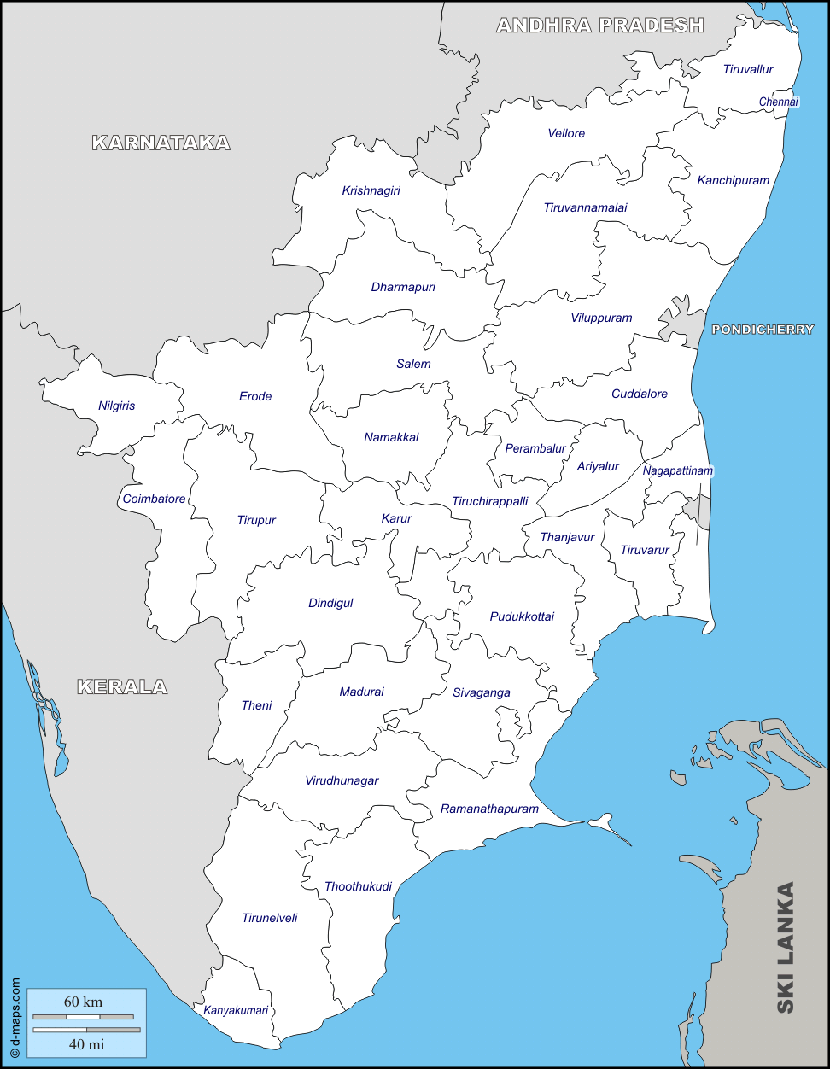
4 Clusters
The TN STEMI Program
Madras Medical Mission Hospital
Metro Specialty hospital
Stanley Medical College Hospital
Tertiary care Government hospital
CMC Vellore
Rural tertiary care hospital
Kovai Medical Centre and Hospital
Urban specialty hospital

Slide 8
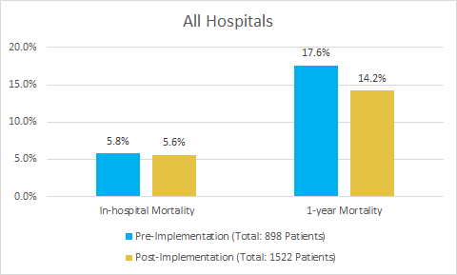
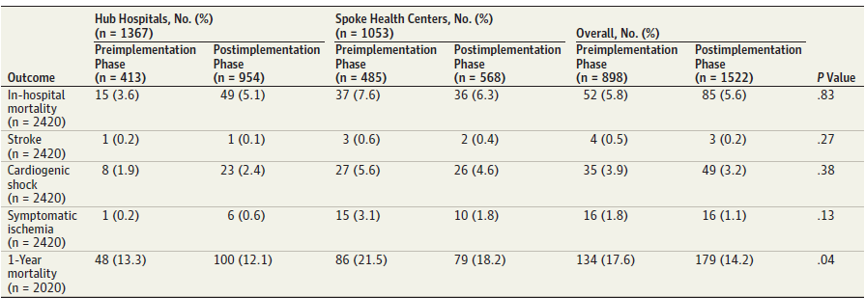
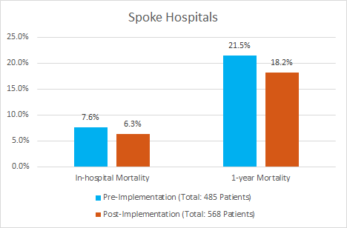
Reduction in Mortality
The TN STEMI Program
STEMI INDIA Model
1-year follow up: 2,020 patients out of 2,420
1-year follow up: 834 patients out of 1,053
Dr Thomas Alexander

Slide 9
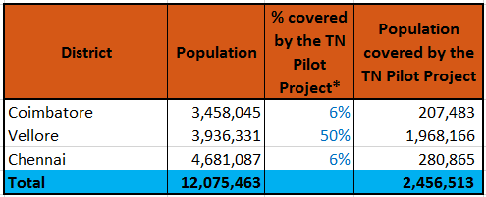
The TN STEMI Pilot Project
2.5 mn people covered across 3 districts
Dr Thomas Alexander

Slide 10
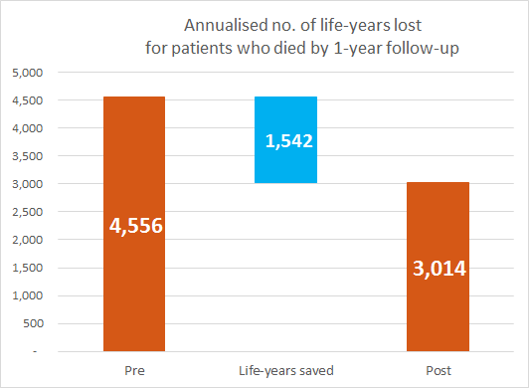
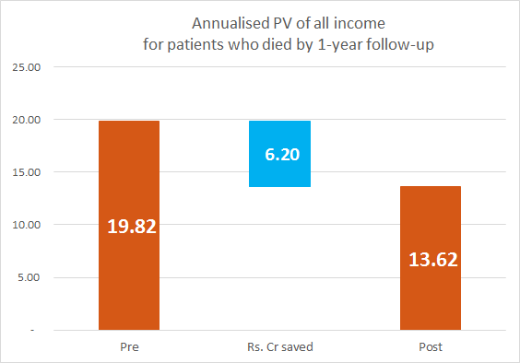
1,542 life-years saved
The TN STEMI Program
STEMI INDIA Model
Benefit-Cost Ratio
Rs. 62 mn saved per year
Rs 3.58 economic benefit gained per rupee spent
Dr Thomas Alexander

Slide 11
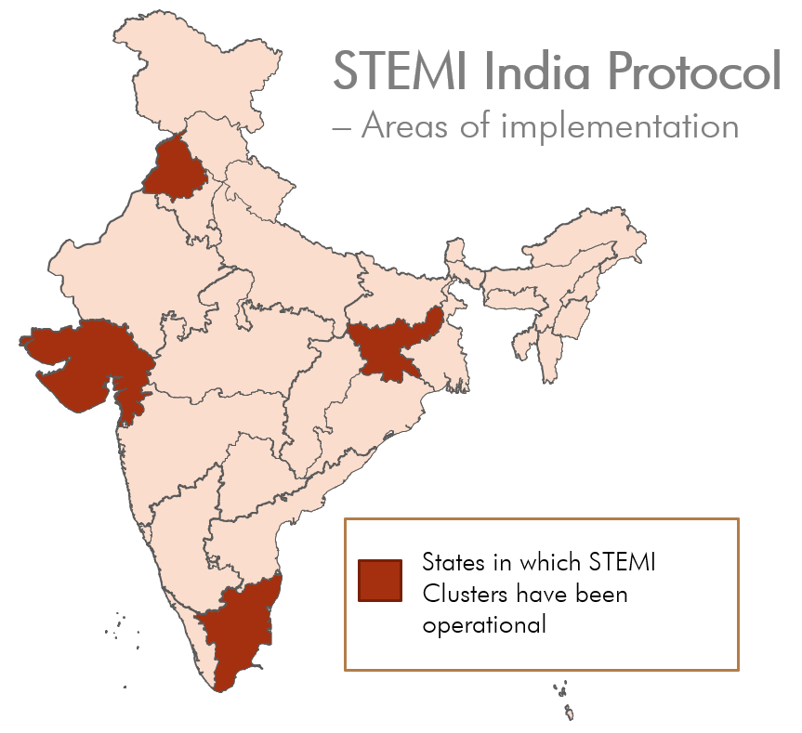
The National Protocol for STEMI
Recommended by
ICMR
CSI
API

Slide 12
The project was successful on several levels:
At the individual level:
As users of the healthcare system, patients were beneficially impacted by the intervention with outcomes of mortality. (134 [17.6%] vs 179 [14.2%]; P = .04)
At the institutional level:
At the infrastructure level, more patients accessed PCI through the pharmacoinvasive treatment during the intervention as compared to the base case without any increase in fixed costs, indicating the infrastructure throughput was increased. (191 0f 413 {46.3%} vs 601 of 954 {63%}; P .001).
Considerable capacity building for staff at spokes which helped train these staff understand and deal with STEMI patients in a better and more appropriate fashion.
At the society level:
As demonstrated in the cost-benefit analysis, the program was economically beneficial for the state and successful in improving the lives of the citizens that it impacted. Cost benefit ratio is 3.98.
Dr Thomas Alexander

Slide 13
Outcomes
Reduction in patient mortality
Mortality due to STEMI reduced by at least 3% on average as compared to the base-case (as observed in the TN Pilot Project).
Patient treatment strategies shift from stand-alone thrombolysis to Primary PCI or pharmaco-invasive
Increased patient footfall
Stronger linkages with nominated spoke hospitals, enabling access to state-of-the-art STEMI treatment to all patients in the region
Better data and analytics
Real-time, accurate data from the entire region, leading to a better understanding of gaps in treatment
Monthly and quarterly reports and dashboards for deeper understanding of patient demographic
STEMI India accreditation
Cerification to accredit participating hospitals as implementors of the National STEMI Protocol
Increased readiness of EMS
Emergency services' ability to handle patients presenting with chest pain upgraded in terms of
Technology
Paramedic skills
Management protocols
Patient awareness
Listing on Cardiacare app as STEMI India accredited hospitals

Slide 14
5 Key Aspects for the success of the Program
The STEMI India Model
Dedicated Agency for Program Implementation
Collaboration with Government
Integrating Hardware and Software including Tele ECG services
to ensure data entry, remote diagnosis and correct treatment strategy via algorithm
To enable data storage on the cloud and ensure optimum treatment strategy via pre-programmed algorithm
Partnership with Ambulance Network
To give all patients access and facilitate inter-hospital transfers
State-wide Insurance Scheme
To ensure that all patients – especially the poor and disadvantaged can benefit
Special Categories opened specifically for the STEMI Program to cover thrombolysis, Primary PCI as well as Pharmaco-invasive methods
Participating hospitals green-channelled
Dr Thomas Alexander

Slide 15
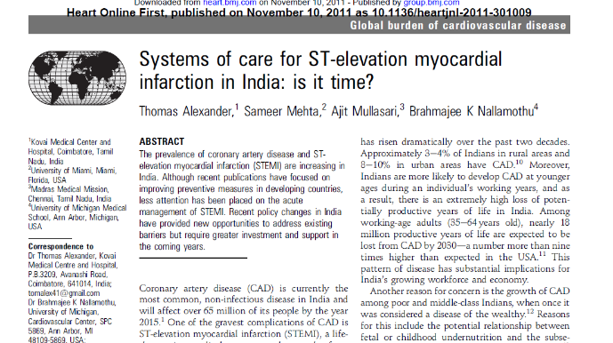
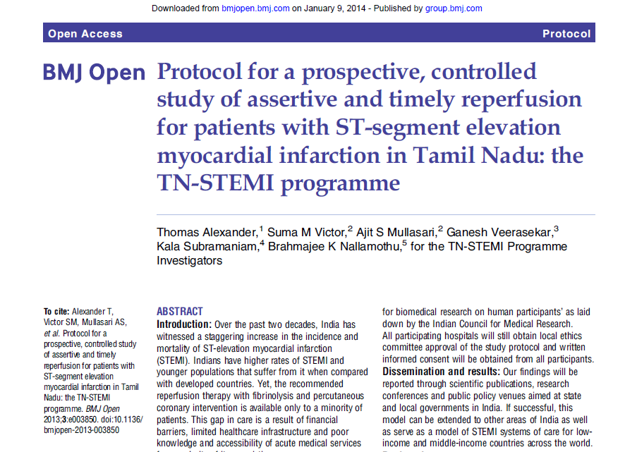
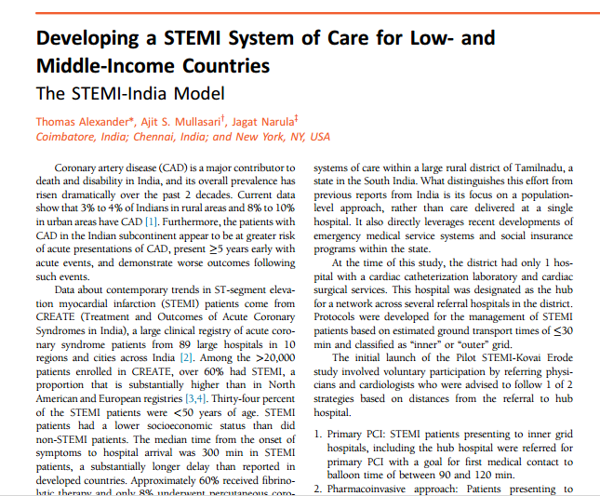
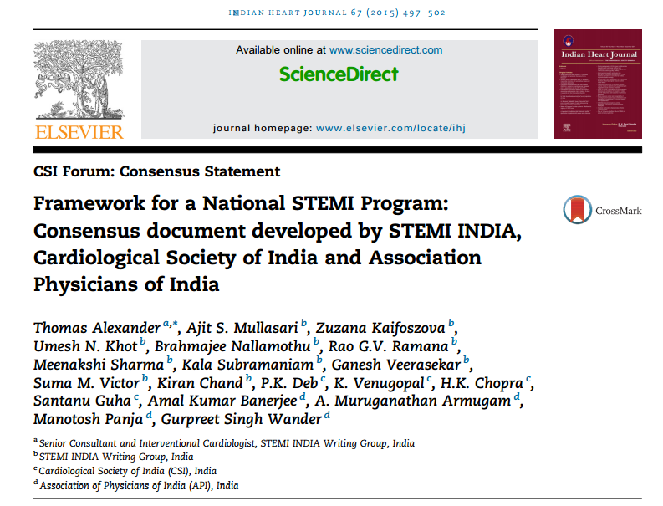
2011
Studies Published
2013
2014
2015
2017
2020
2021
Dr Thomas Alexander

Slide 16
Agenda
The TN STEMI Program and the STEMI India Model
Challenges in STEMI Management
Benefits of a STEMI System of Care
Infrastructure appropriate variations of the Hub and Spoke Model
Implementation of the STEMI India Model
Global Programs
Dr Thomas Alexander

Slide 17
Estimate (Guesstimate) of STEMI in India
STEMI in India - Challenges
US data from Worcester MA – 1,210 to 770 per million from 1997 to 2005
European data - 750 to 1,250 per million
India – 2,000 MI per million – 2.4 million MI per year
Over 1.75 million patients with STEMI yearly
Dr Thomas Alexander

Slide 18
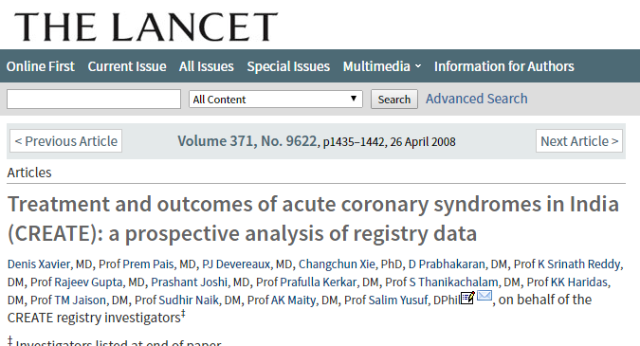
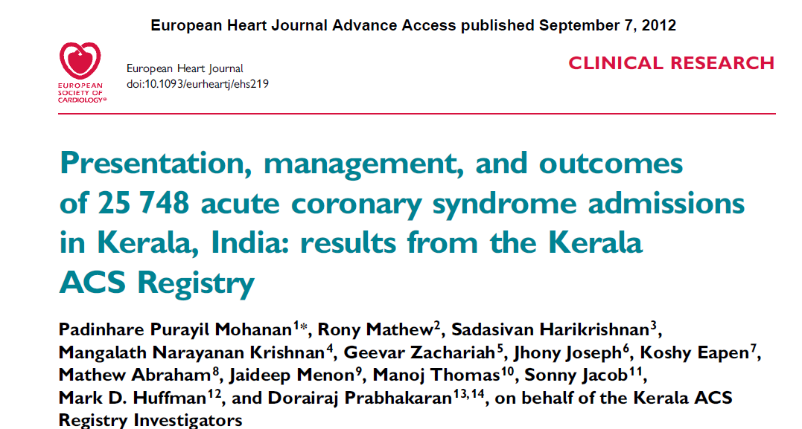
CREATE Registry
Kerala ACS Registry
A 4-year (2001-05) prospective registry study
89 centres from 10 regions and 50 cities in India
20,468 patients with ACS of which 12,405 had a STEMI
34% of STEMI were below 50 years
58.5% received thrombolytic and 8% PPCI
Median time from symptoms to hospital was 360 (range 123-1317) minutes
Only 4% travelled by ambulance
Most patients pay directly for treatment
25,748 patients – 2007 to 2009 in 125 hospitals
37% of ACS presented as STEMI
Age of presentation 60.4 years
Symptom onset to presentation > 6hrs in 41% patients
41.4% received thrombolytic and 12.9 % PPCIs
8.2% in-hospital mortality
Dr Thomas Alexander

Slide 19
Thomas Alexander

Slide 20
100 Untreated STEMI – Hospital discharge alive 60
1 year – 50
5 years - 30
10 year - 15
Dr Thomas Alexander

Slide 21
Patients by age
Dr Thomas Alexander

Slide 22
Treatments by SES
 | Rich | UMC | LMC | Poor | p
Thrombolysis | 61% | 65% | 63% | 52% | *
Cor Angio | 41% | 36% | 22% | 9% | *
PCI | 15% | 13% | 6% | 2% | *
CABG | 8% | 5% | 2% | 1% | *
Antiplatelet | 97% | 98% | 98% | 98%
Beta blocker | 59% | 61% | 62% | 50% | *
Lipid lowering | 61% | 59% | 54% | 36% | *
ACEI/ARB | 63% | 57% | 57% | 54% | *
Dr Thomas Alexander

Slide 23
Mortality by SES
 | Rich | UMC | LMC | Poor | P
Death rate (un-adj) | 5.5 | 5.9 | 6.5 | 8.2 | <0.0001
Death rate (adj-RFs) | 5.1 1.0 | 5.9 1.16 | 6.7 1.32 | 7.8 1.57 | 0.0093
Death rate (adj-RF+Trt) | 6.9 1.0 | 7.0 1.01 | 6.5 0.94 | 6.7 0.96 | 0.9487
RF: age, sex, prev MI, DM, HTN, smoking, BP, HR, Killip, BMI
Trt: type of hospital, time to hosp, in-hospital drugs, interventions.
Dr Thomas Alexander
Notes:
23

Slide 24
Agenda
The TN STEMI Program and the STEMI India Model
Challenges in STEMI Management
Benefits of a STEMI System of Care
Infrastructure appropriate variations of the Hub and Spoke Model
Implementation of the STEMI India Model
Global Programs
Dr Thomas Alexander

Slide 25
Better treatment strategies
Dr Thomas Alexander

Slide 26
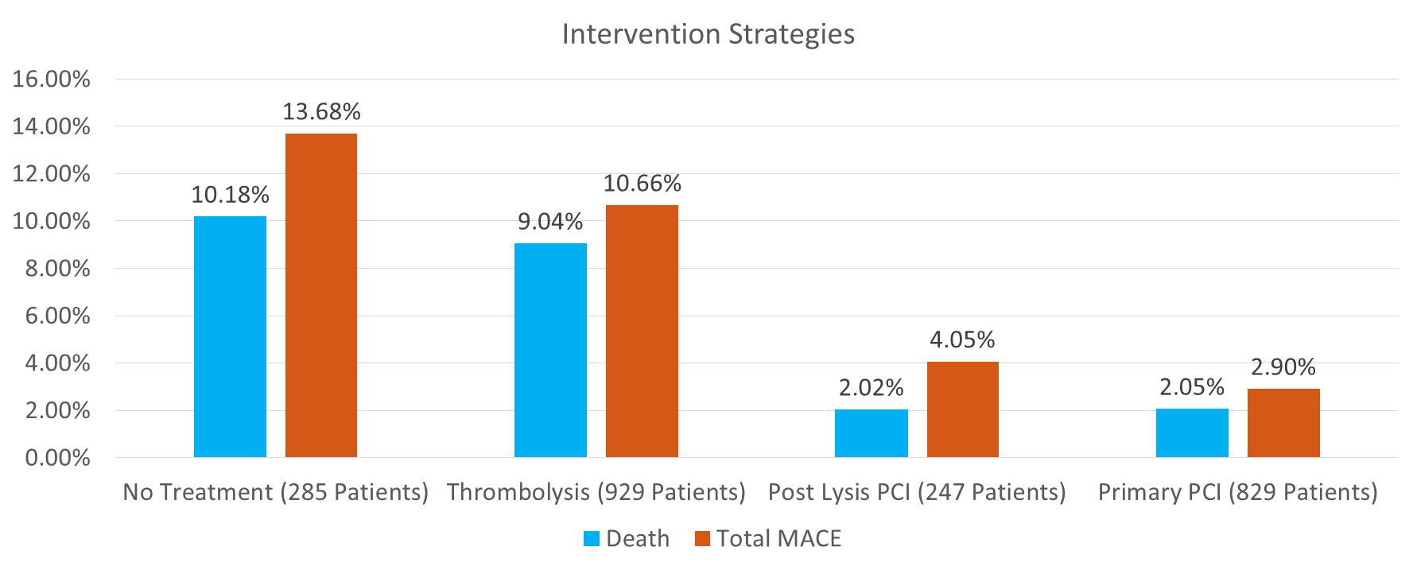
In-hospital MACE based on Type of Intervention
The TN STEMI Program – Pharmacoinvasive subset
Dr Thomas Alexander

Slide 27
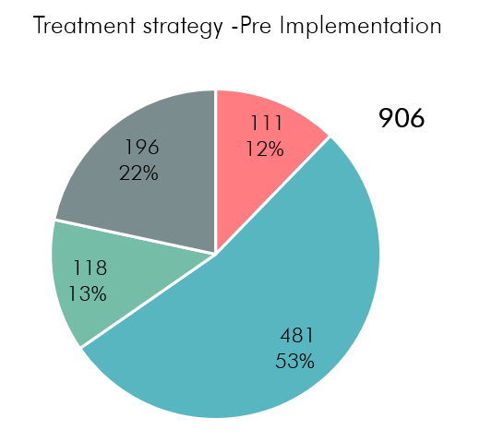
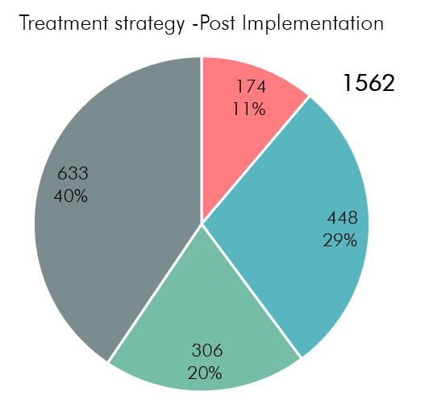
Tamil Nadu – shift from standalone thrombolysis to primary PCI and the pharmaco-invasive method
Dr Thomas Alexander

Slide 28
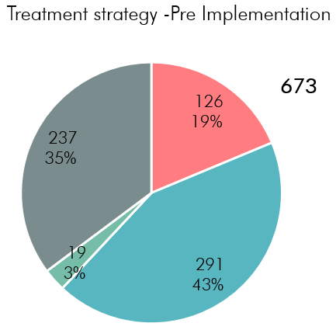
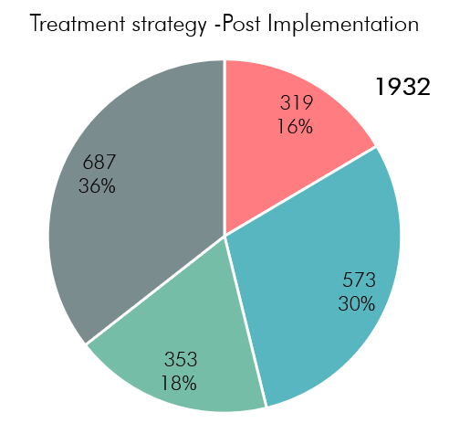
Gujarat – shift from standalone thrombolysis to the pharmaco-invasive method
Dr Thomas Alexander

Slide 29
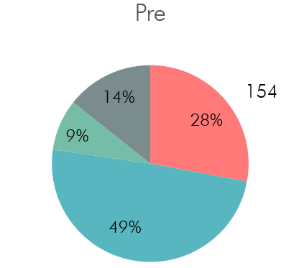
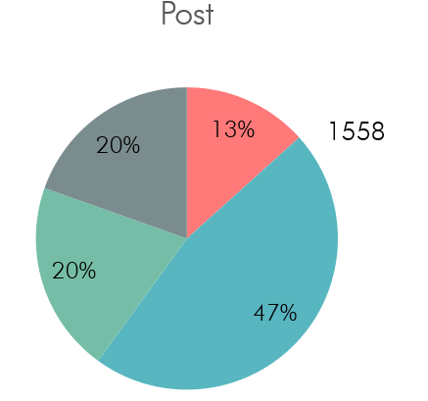
Punjab - no treatment decreased; 1.7X increase (23% to 40%) in superior strategies
Dr Thomas Alexander

Slide 30
Outcomes
Dr Thomas Alexander

Slide 31
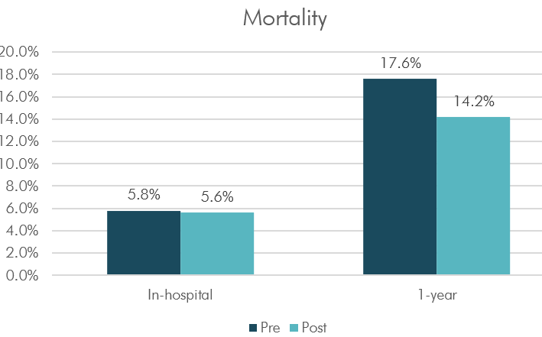
Tamil Nadu – 1-year outcomes improved significantly
Dr Thomas Alexander

Slide 32
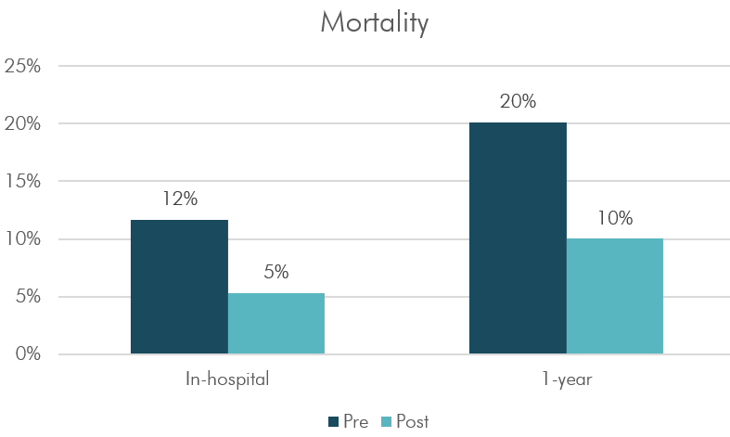
Punjab – both in-hospital and 1-year outcomes improved
Dr Thomas Alexander

Slide 33
Why the STEMI India Model works
Efficient use of existing resources by setting systems in place
Flexibility allowing for adaptation according to unique conditions in the region
Equips field staff and enables sustainability in the long-run through continuous training
Modular and scalable across the state
Thomas Alexander

Slide 34
Agenda
The TN STEMI Program and the STEMI India Model
Challenges in STEMI Management
Benefits of a STEMI System of Care
Infrastructure appropriate variations of the Hub and Spoke Model
Implementation of the STEMI India Model
Global Programs
Dr Thomas Alexander

Slide 35
Model -1
WHEN THE DISTRICT HAS NO TERTIARY HOSPITALS WITHIN A DRIVING DISTANCE OF 2 HOURS
Dr Thomas Alexander

Slide 36
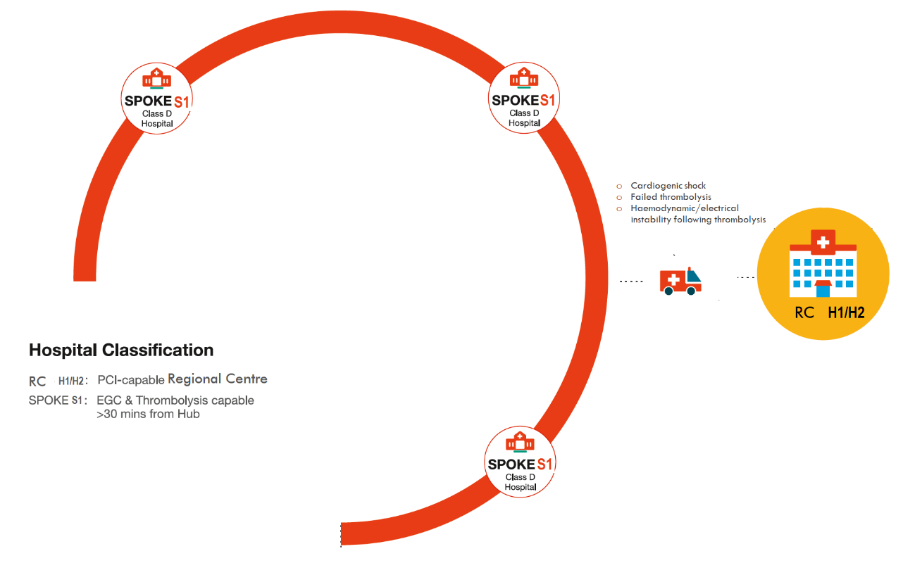
The Tele-ECG Thrombolysis-only Model
For regions where cath lab is further than 2 hours away
Links created
Remote diagnosis of STEMI through the STEMI Kit
Spokes all linked to the closest available tertiary centre for remote diagnosis and for follow-up care if necessary
a
Remote diagnosis

Slide 37
The Thrombolysis-only STEMI India Model
The STEMI India Model
Links created
Remote diagnosis of STEMI through the STEMI Kit
Spokes all linked to the closest available tertiary centre for remote diagnosis and for follow-up care if necessary
Linkages built on
Electronic Data Communication
Management Protocols
Insurance reimbursement
Dedicated EMS Network
Tele-ECG

Slide 38
The Tele-CCU Thrombolysis-only STEMI India Model
Links created
Remote diagnosis and handholding through AV and other appropriate channels for management of MI
Spokes all linked to the closest available tertiary centre for remote diagnosis and for follow-up care if necessary
Linkages built on
Electronic Data Communication
Management Protocols
Insurance reimbursement
Dedicated EMS Network
Tele-CCU

Slide 39
Model -2
WHEN THE DISTRICT HAS A TERTIARY HOSPITALS WITHIN A DRIVING DISTANCE OF 2 HOURS
Dr Thomas Alexander

Slide 40
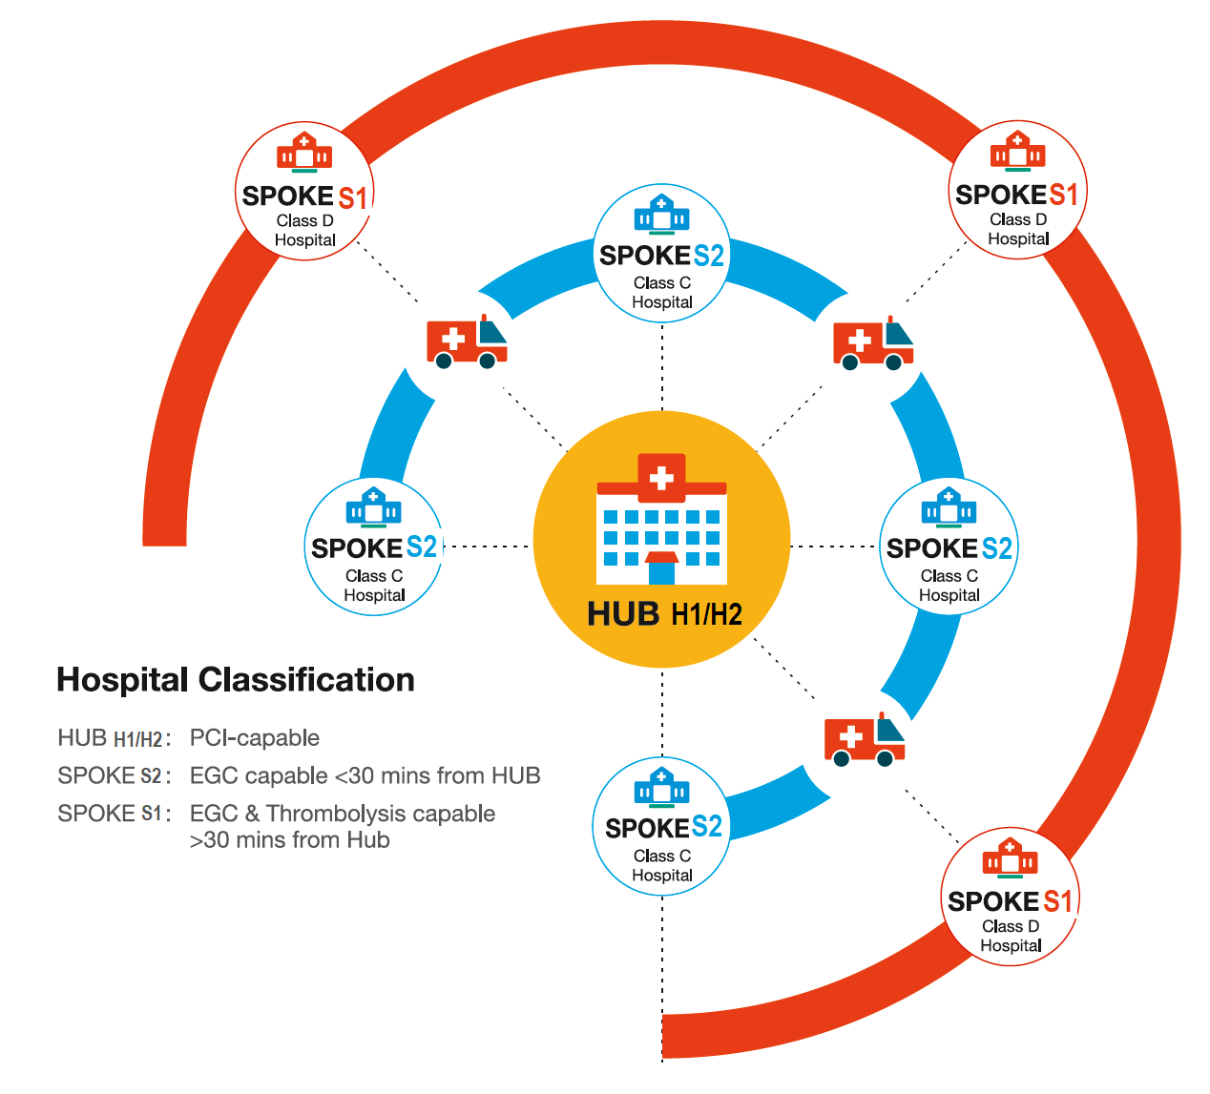
The Standard STEMI India Model
The STEMI India Model
Cluster created
Hub-and-spoke model
Linkages built on
Electronic Data Communication
Management Protocols
Insurance reimbursement
Dedicated EMS Network

Slide 41
Model -3
PRIMARY PCI MODEL
Dr Thomas Alexander

Slide 42
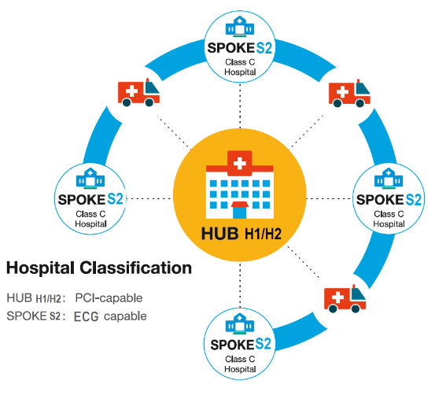
Model 3 The Primary PCI STEMI India Model
Up to 15 ECG-capable (S2) hospitals linked to a tertiary care centre with a cath lab (H1/H2) within 30 minutes’ driving distance
ECG machines and appropriate software installed in hospitals and ambulances
Periodic and continuous training provided
Tele-ECG support available
All patients diagnosed with STEMI at S2 immediately transferred in ambulances to H1/H2 for primary PCI

Slide 43
Agenda
The TN STEMI Program and the STEMI India Model
Challenges in STEMI Management
Benefits of a STEMI System of Care
Infrastructure appropriate variations of the Hub and Spoke Model
Implementation of the STEMI India Model
Global Programs
Dr Thomas Alexander

Slide 44
Components of a STEMI programme
Dr Thomas Alexander

Slide 45
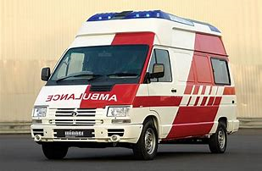
STEMI System of Care:
Ambulance
Hardware
Software
ECG Diagnosis
Protocols
Training
Analytics
Governance
Dr Thomas Alexander

Slide 46
Dr Thomas Alexander

Slide 47
Digital Tools
Implementation of the STEMI India Model
THE STEMI INDIA MODEL
Dr Thomas Alexander

Slide 48
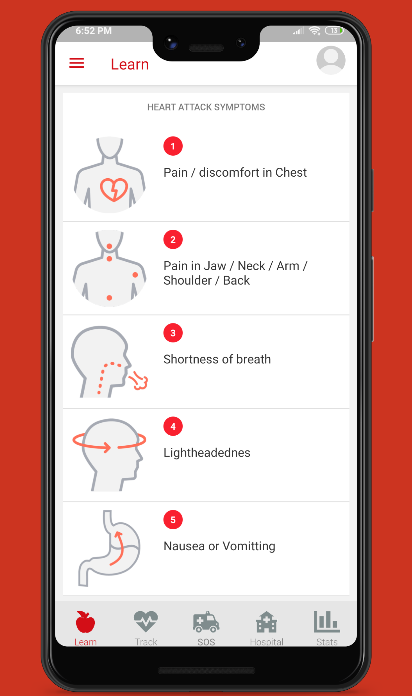
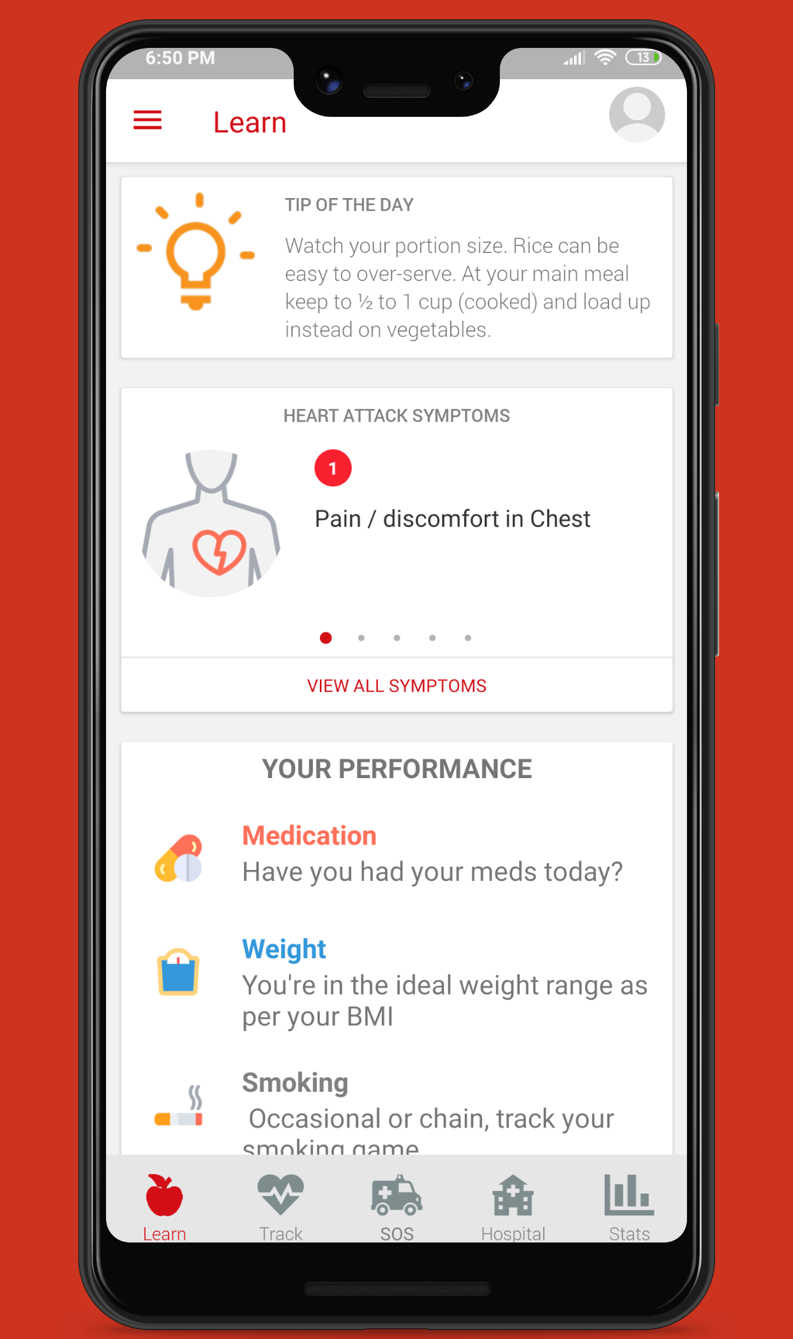
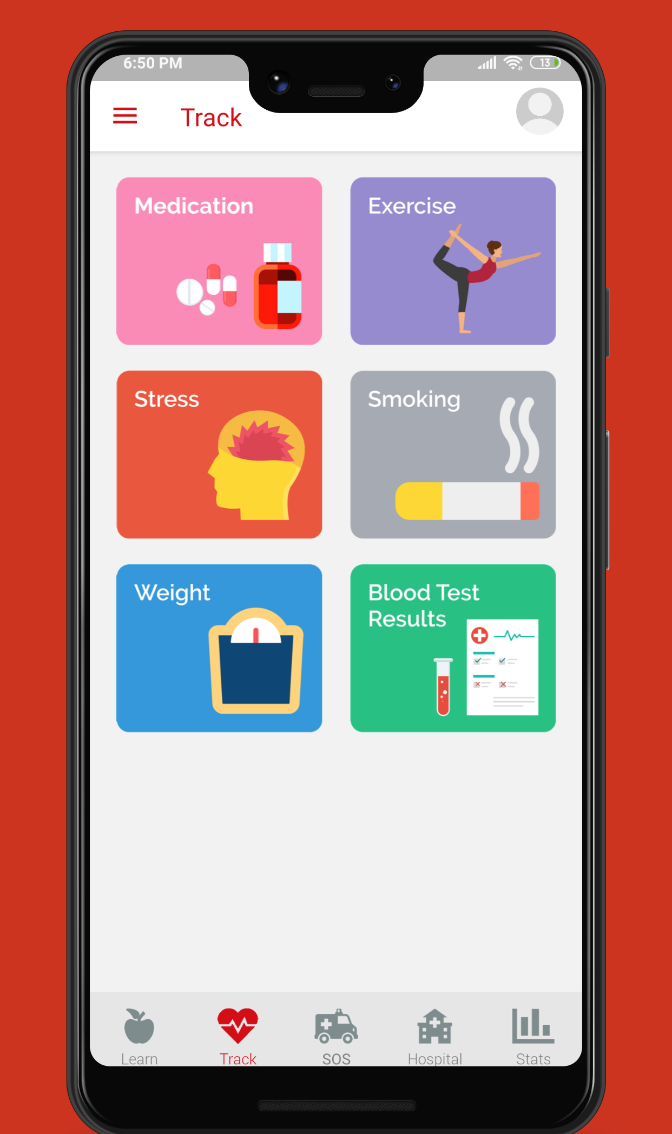

Slide 49
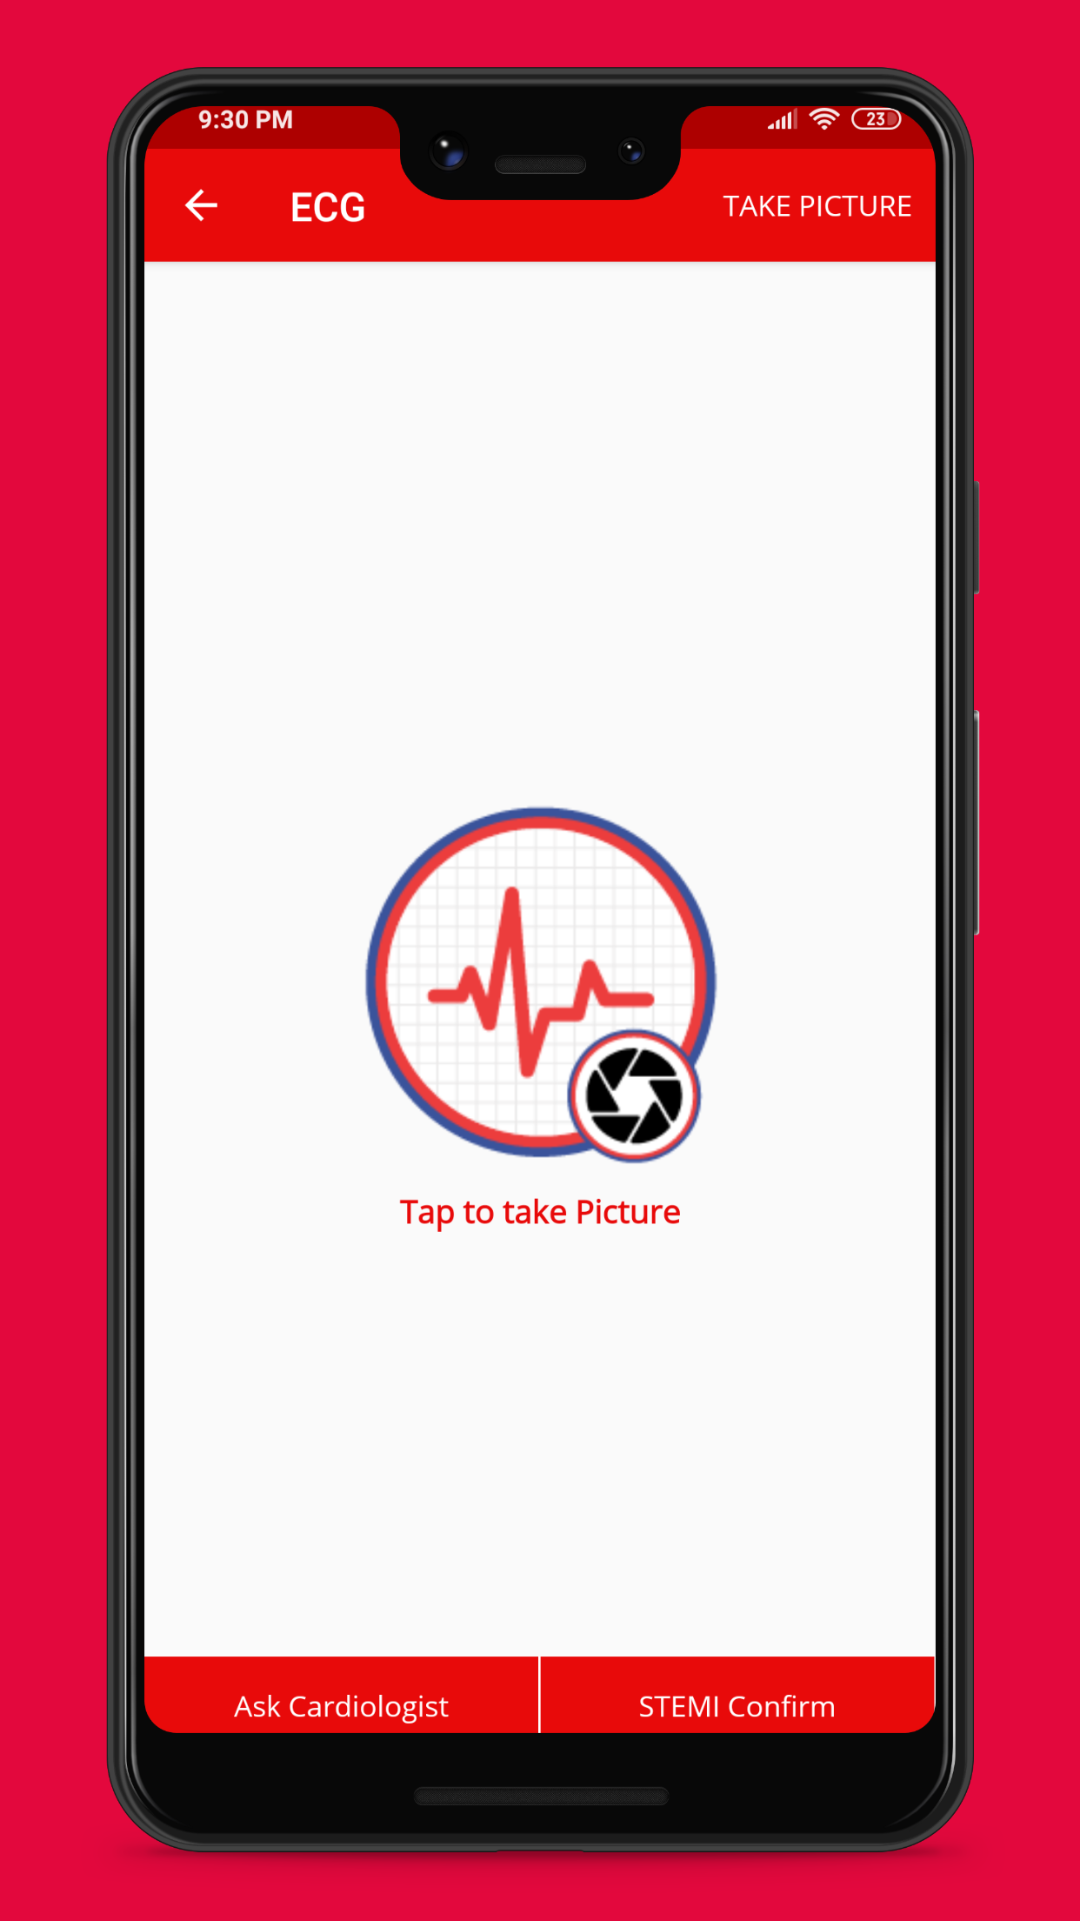
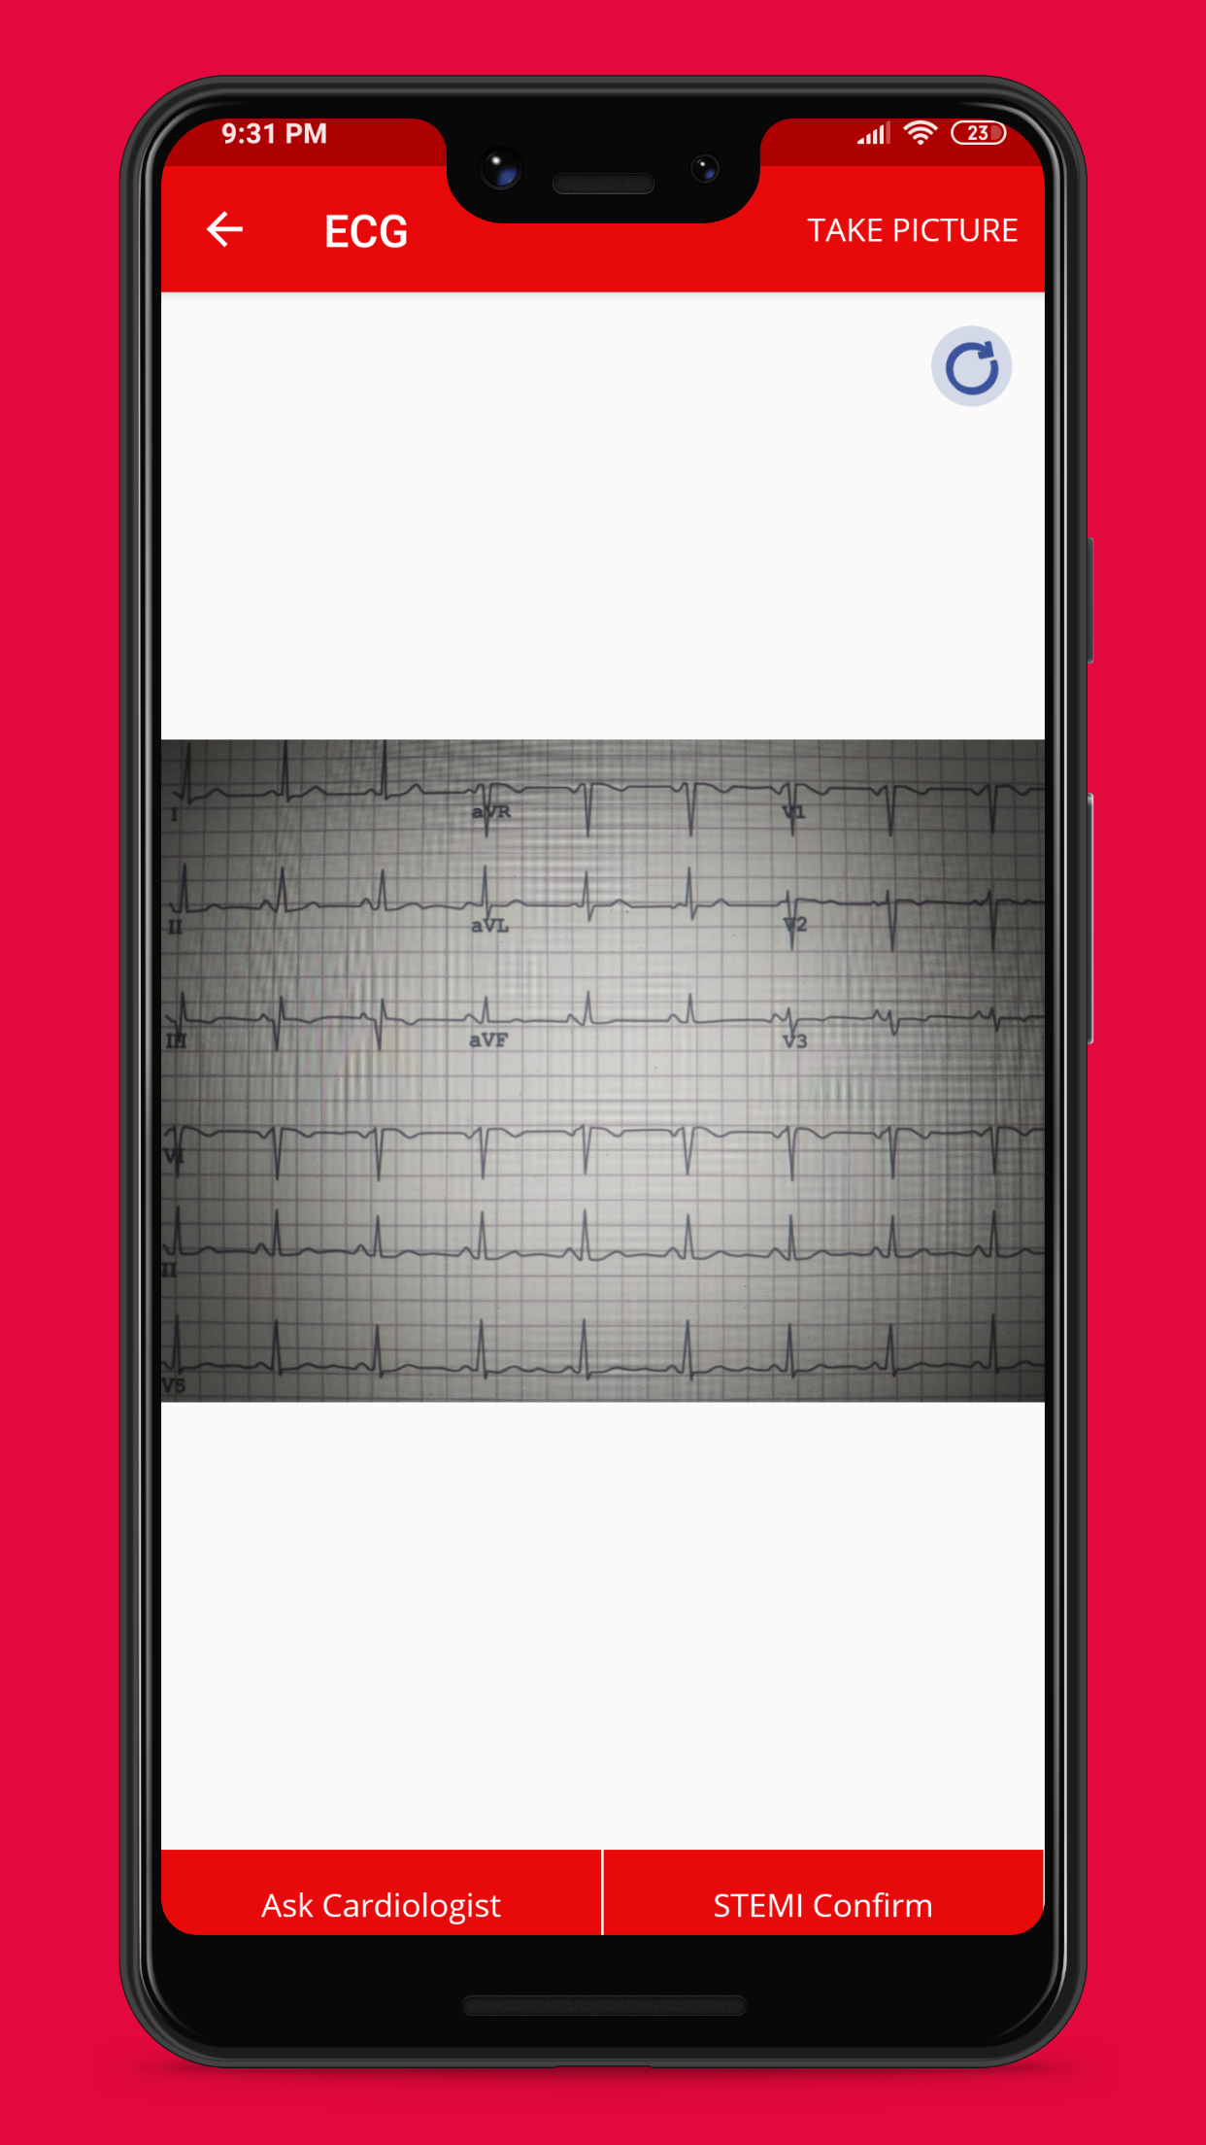
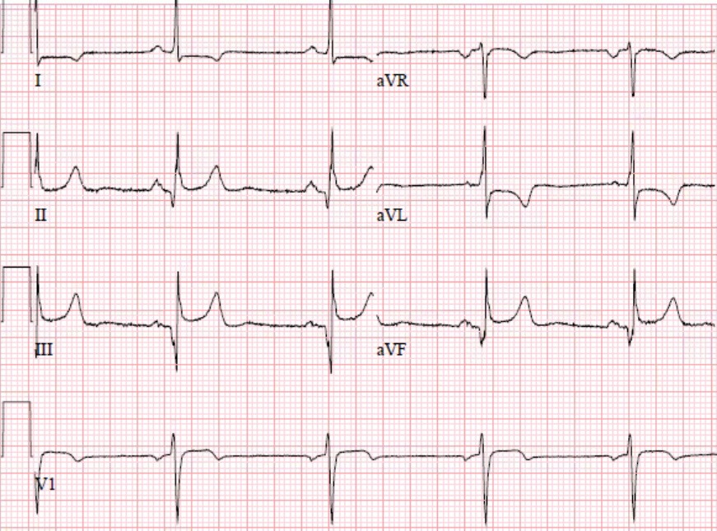
Dr Thomas Alexander

Slide 50
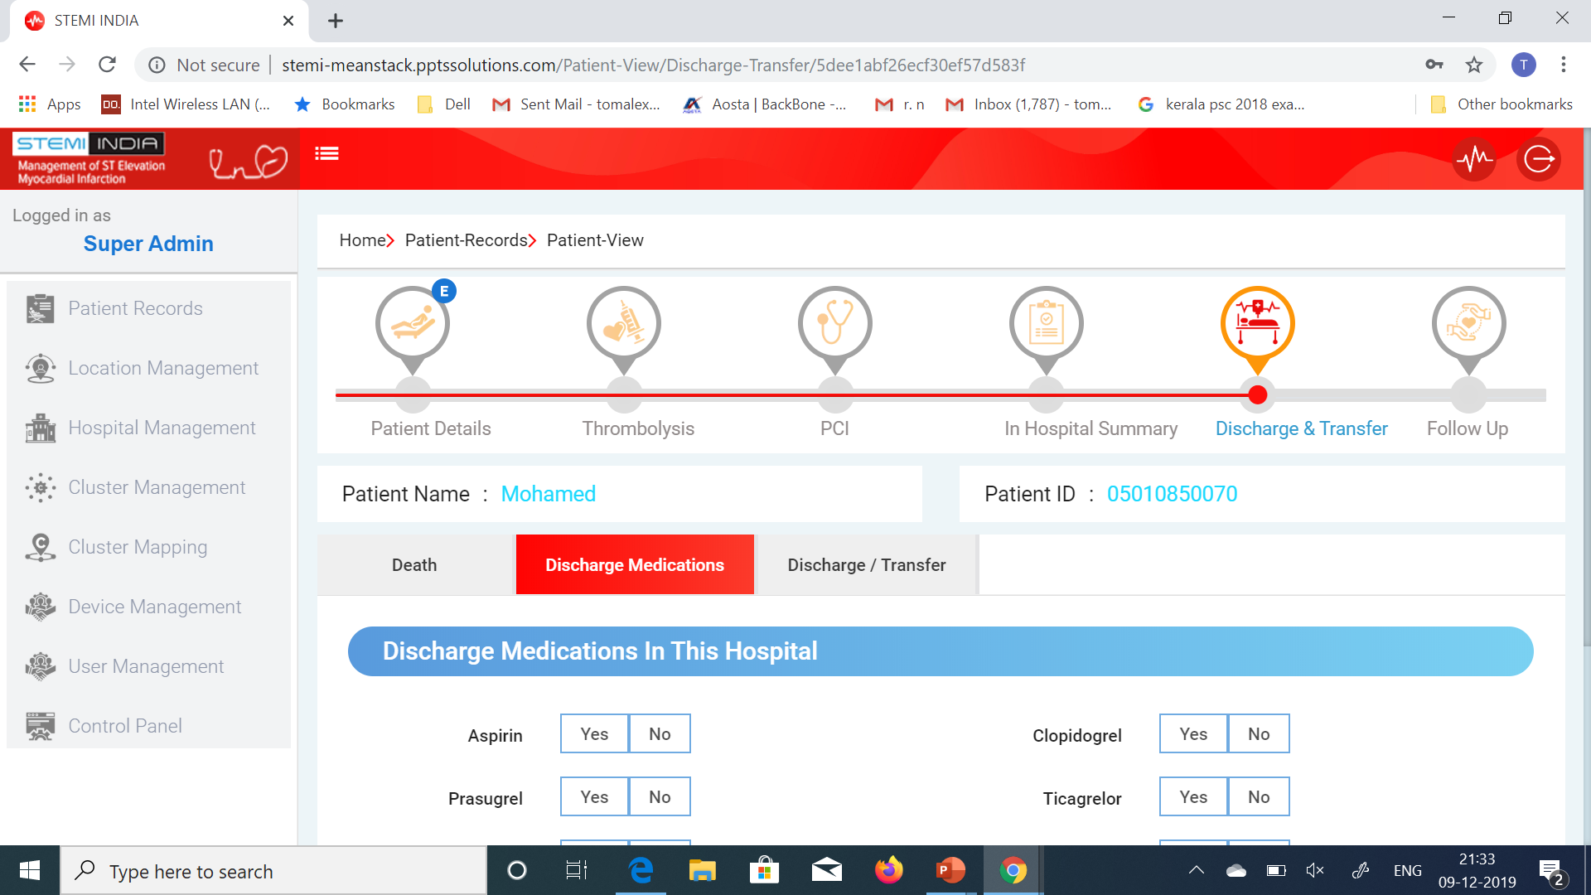
Thomas Alexander

Slide 51
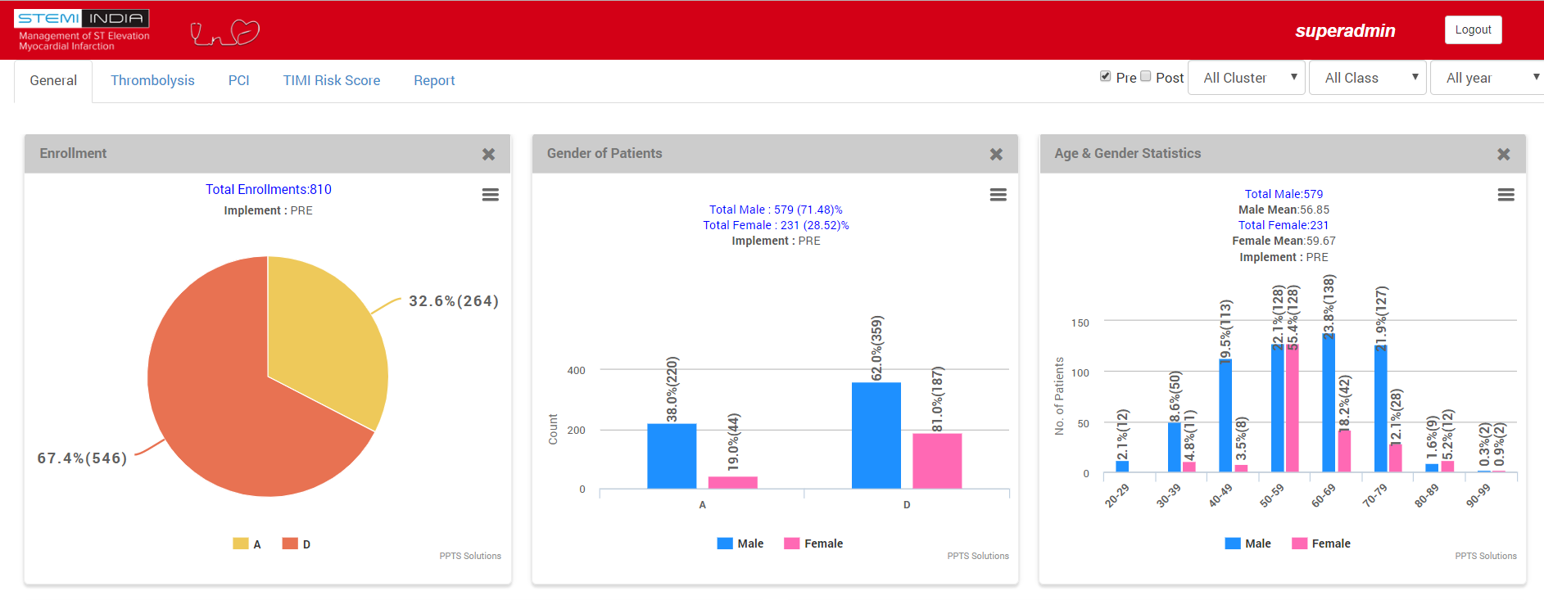
Dr. Thomas Alexander

Slide 52
Agenda
The TN STEMI Program and the STEMI India Model
Challenges in STEMI Management
Benefits of a STEMI System of Care
Infrastructure appropriate variations of the Hub and Spoke Model
Implementation of the STEMI India Model
Global Programs and Private Initiatives
Dr Thomas Alexander

Slide 53
A worldwide initiative to improve patient outcomes suffering from myocardial infarction
Stent – Save a Life!
Endorsed by

Slide 54
Choosing a country for the pilot project
Strong local leadership and broad acceptability across the country
Strong ties with local government and ambulance services
Reperfusion therapy and ambulance service funded by governments/insurance
Funding of local project personnel to be taken care by host SSL
Availability of funding to run the program
Preferable to have a tripartite agreement – Global SSL, Local SSL and Government
South Africa
Sudan
Egypt
Peru
Azerbaijan

Slide 55
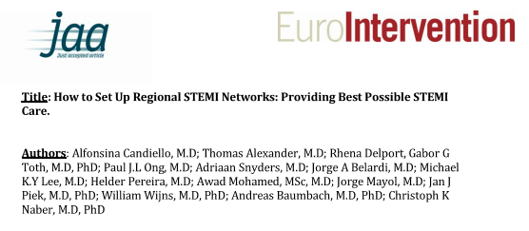

Slide 56
STEMI Care India
STEMI India’s Protocol
Efficacy proven by TN Pilot Project studying 2,500 patients
Has increased patient footfall in 3 states across India
Mapping
Geographic mapping
Facilities and manpower mapping
Cluster Formation
Training
Deliverables
Clinical training for spokes
Continual periodic training on protocol application
Certification
Hospitals given STEMI India accreditation
STEMI India Software
Comprehensive data collection
Real-time dashboard and analytics
Project Operations
Full-time field staff for spoke engagement and training
Licenses to use proprietary software in all participating hospitals and secure data storage on the cloud
Periodic reports on patient flow

Slide 57
Thank you

